Slide 1

Unit 3: Lesson 5 Transformation challenge

Slide 2
Task 1: Have you ever followed any fitness training programmes on YouTube?
Task 2: Scan the webpage and answer the questions.
1 Transformation challenge lasts for 8 weeks.
2 Alisha Patel comes from Australia and Jean Robert comes from France.
3 The meal plan is based on the information provided during registration.
4 No, they don’t.
5 In the database you can find over 200 videos and more than 150 recipes.
6 Yes, they can.

Slide 3
Task 3: Listen to the text and fill in the registration form with Andy’s information.
https://www.e-sfera.hr/dodatni-digitalni-sadrzaji/135e8ce3-d5bf-4940-b80c-3defdd17ea4e/
Andy Brown
052 996 6321
andybrown@gmail.com
Yes, I have.
1,85
100 kilos
Yes, I have. It was successful at first, but I tend to lose motivation quickly and need a lot of support.
22
I’m lactose intolerant.
I expect to lose some weight and gain core strength and flexibility. Also, I would like to eat healthier.
No, I haven’t.

Slide 4
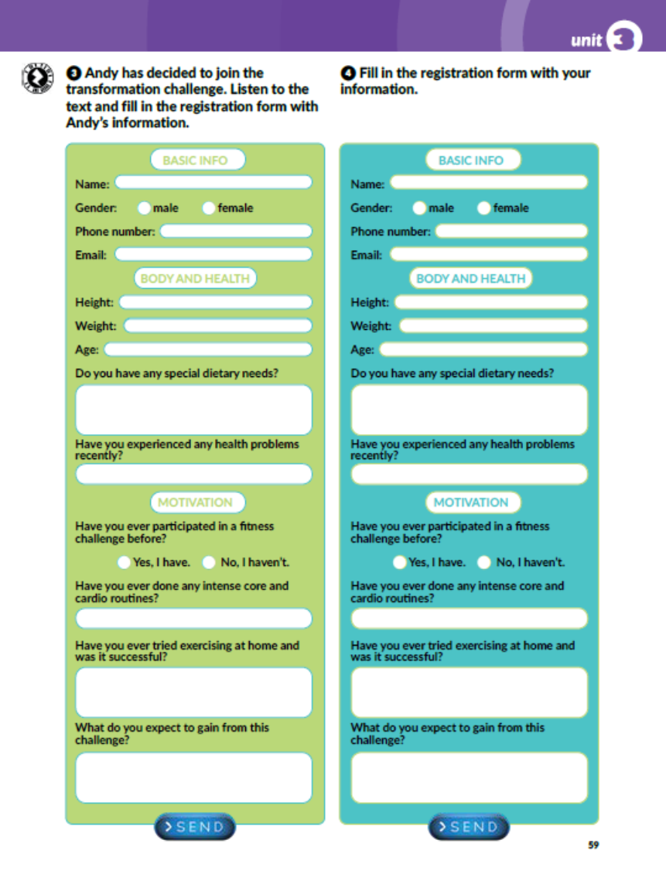
Task 4: Fill in the registration form with your information.

Slide 5
Task 1: Match the questions to Andy’s answers.
5
2
6
3
7
8
4

Slide 6
Task 2: Sumarize Andy’s answers and write a short report.

Slide 7

PLAY AND LEARN!
https://www.e-sfera.hr/dodatni-digitalni-sadrzaji/135e8ce3-d5bf-4940-b80c-3defdd17ea4e/

